Slide 1
Lyra: An Interactive Visualization Design Environment. – by Arvind Satyanarayana and Jeffrey Heer
Rajath Vijapur Prakash Rao
Notes:
Links- Lyra page and Research paper
http://idl.cs.washington.edu/projects/lyra/
https://idl.cs.washington.edu/files/2014-Lyra-EuroVis.pdf
http://idl.cs.washington.edu/projects/lyra/

Slide 2
Content
About the paper
Lyra- what is it?
Related work- Foundations
Design of Lyra
Evaluation
Study & Conclusion

Slide 3
About the paper
Presented at the Euroviz conference in 2014.
The paper discusses about one specific tool called Lyra.
The study is important because it gives a detailed description of the tool, the principles used in designing the tool and its scope.
The paper also covers the usability test on the subject group.
The paper presents its findings from the study.

Slide 4
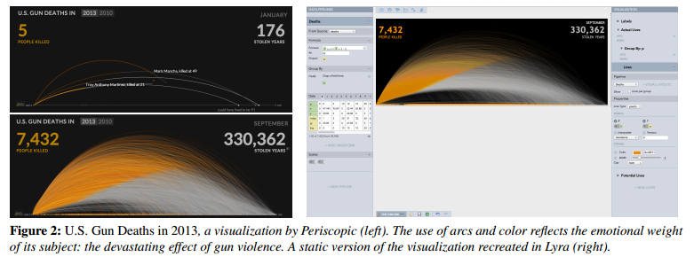
Lyra- what is it?
Is a web based tool for creating visualizations.
It provides a interactive design environment.
Targeted to help people without a coding background.
Mainly used to recreate complex data visualizations.
Ex- US gun killing, Napoleon's army march
It creates a still image.
Notes:
http://guns.periscopic.com/?year=2010

Slide 5
Related work Lyra is built based on the below concepts
Chart typologies- Set of chart templates- allows to select rather than create. Limited options. Ex-google fusion tables
Lyra supports exporting and more flexible chart typologies
Visualization tool kits- using programming languages like D3.
Lyra provides similar features without the requirement for programming.
Visualization grammar- Lyra gives the best of both worlds-rapid explanatory analysis and programming based analysis (d3.js)
Interactive data visualization tools- Similar to Tableau-drag and drop features. Complex features to alter the mark is also available, similar to D3.

Slide 6
Design of Lyra
The Vega Visualization grammar- The Lyra is built on Vega grammar. The Vega grammar provides basic abstraction. Uses a declarative JSON format (VEGA JSON)- Static PNG or SVG image (export formats)
Some terminologies-
Data- Tabular data model
Data transforms- transforms data prior to visualization- Statistically, visually etc.
Scales- Scales are functions that map data values to visual properties such as position, shape, and color. Lyra includes both ordinal and quantitative (e.g., linear, log, quantile) scales, along with common shape and color palettes.
Guides- ex- Axis and Legends. They help visualize scales
Marks- geometric shapes available- ex – rectangle, arc, area, line
Handles can be used to interactively move, rotate, and resize mark
Connectors relatively position the mark
Drop zone allows data binding via drag-drop

Slide 7
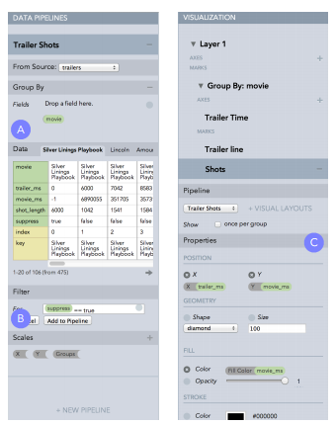

Design of Lyra continued..
Interface- left panel, right panel and
Central panel.
Left- data pipelines
Right- marks, axes and legends
Center- canvas for direct manipulation.
Drop zone-

Slide 8
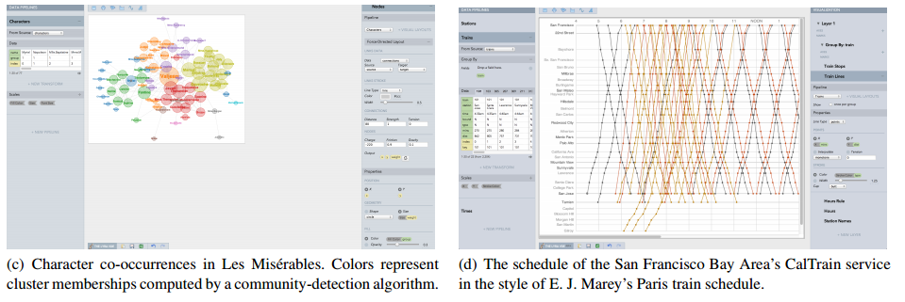
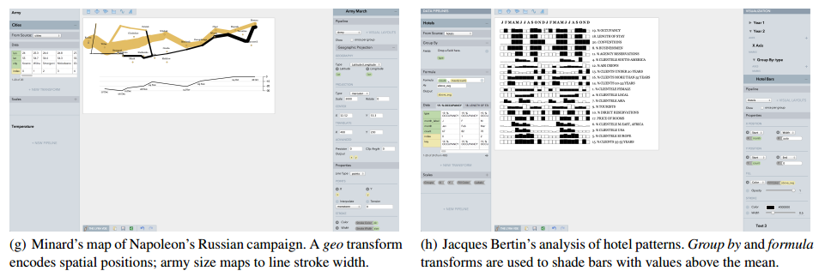
Evaluation of Lyra
Creating complex visualization to check the effectiveness of Lyra

Slide 9
First use Study-Details
15 representative users including 6 data analysts / visualization designers, 5 data journalists, and 4 graduate students in data visualization
The median self-reported visualization design expertise was 7 on a 10-point scale, while programming expertise ranged between 2–8 on a 10-point scale
These users all use visualization as a communicative medium but their processes for creating them vary. The visualization designers and grad students were more technically proficient and typically use D3, whereas the data journalists rely on chart typologies (Microsoft Excel) or grammar-based systems (Tableau) that do not require programming. Some journalists also reported eschewing visualization systems in favor of drawing programs such as Adobe Illustrator.

Slide 10
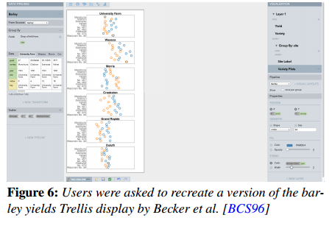
First use study- Methodology
Started with a 10 minute tutorial
Asked to draw 3 graphics
A bar chart of medal count by country at the 2012 Olympics (T1), a grouped or stacked bar chart of medal counts by medal type and country (T2), and a trellis plot of barley yields
These tasks were designed to ensure participants interacted with all aspects of Lyra. Each task was more difficult than the previous, intending to first familiarize participants with the Lyra design process, and then challenge them
Participants were encouraged to think-aloud and the session lasted for 45 minutes

Slide 11
First use study-Successes
Quick learning observed, regardless of background
100% success rate
First two tasks were completed faster. Third task took longer
Post study survey indicated that the users rated the tool highly.
Compared to Tableau shelves
Said it is “intuitive and easy”

Slide 12
First use study-Shortcomings
Drop zone is miniscule and the user strains to see
User would lose mark once dropped on the zone
Lack of support for the undo feature
Blank canvas is intimidating

Slide 13
Discussion and limitations
The study includes limited group of people who are familiar with visualization. This might bring about a bias when concluding that the user interface is intuitive.
The expertise of the subjects is self reported. This needs to be further probed and ratified.
The paper does not seem to wholly justify the use of Lyra. For instance, when there are tools like Tablaeu and D3 why should one invest his/her time to lean this new tool to re-create the same visualizations.
The visualizations created are static. This may not entice the potential user.

Slide 14
THANK YOU!

